Slide 1

Capstone project phase 2
GAN graph embedding
Presentors:
Tzachi Ben Yair
Eden Amir
Advisors:
Dr. Renata Avros
Prof. Zeev Volkovich

Slide 2
Agenda
01
02
03
04
05
06
Problem
Overview
Basic
Concepts
Project
Architecture
Implementation
Conclusions
Results Evaluation
1
Notes:
1

Slide 3
TL;DR
What is an embedding?
The process of representing the nodes and/or edges in a low dimension vector space such that the temporal evolution of the network can be captured mathematically.
Link prediction
Link prediction is a methodology for predicting the likelihood of a future association between a pair of nodes based on previous graph snapshots.
Citations evaluation
The ability to evaluate the authenticity of citations in an article
2

Slide 4

Problem Overview
What are we trying to solve?

Slide 5
Problem Overview
During a research process authors face many challenges:
Avoid misleading references
Attitude expend
Understand articles relations
3
Notes:
The sleeping beauty affect

Slide 6
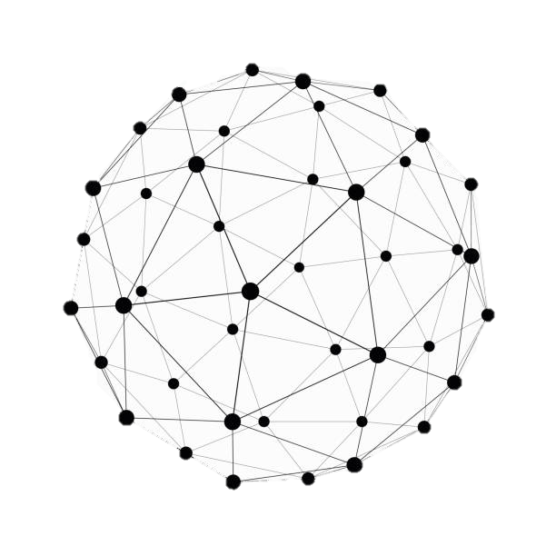
Basic Concepts
GAN and LSTM

Slide 7
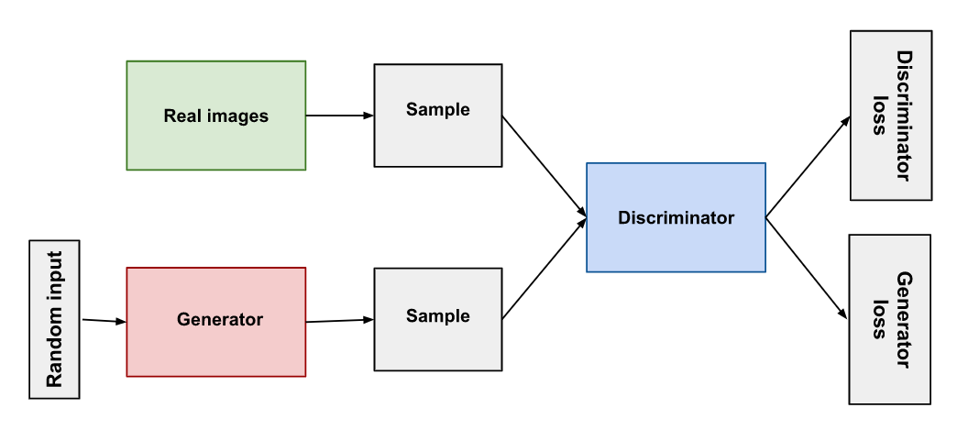
GAN
Generative Adversarial Network intended to produce new data
samples that are similar to a training set.
data
The goal: maximize the discriminator's classification precision
and the generator's ability to fool the discriminator.
4
Notes:
GANs are an unsupervised deep learning model composed of two sub-models: a generator and a discriminator
The generator generates new plausible samples that are indistinguishable from real samples in the dataset
The discriminator classifies generated samples as either real or fake
The generator and discriminator participate in a zero-sum game, where the generator updates itself based on the discriminator's classification
Both sub-models use backpropagation to update the network's weights
GANs learn by implicitly computing similarity between the distribution of a candidate model and the distribution corresponding to actual data
The generator and discriminator are trained iteratively, with the goal of maximizing the discriminator's classification precision and the generator's ability to fool the discriminator.

Slide 8
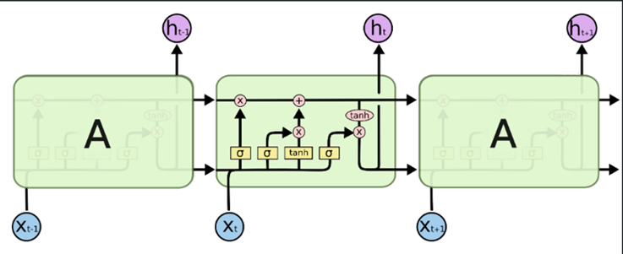
LSTM
A type of the RNN architecture that is able to effectively capture long-term dependencies in sequential data.
5

Slide 9
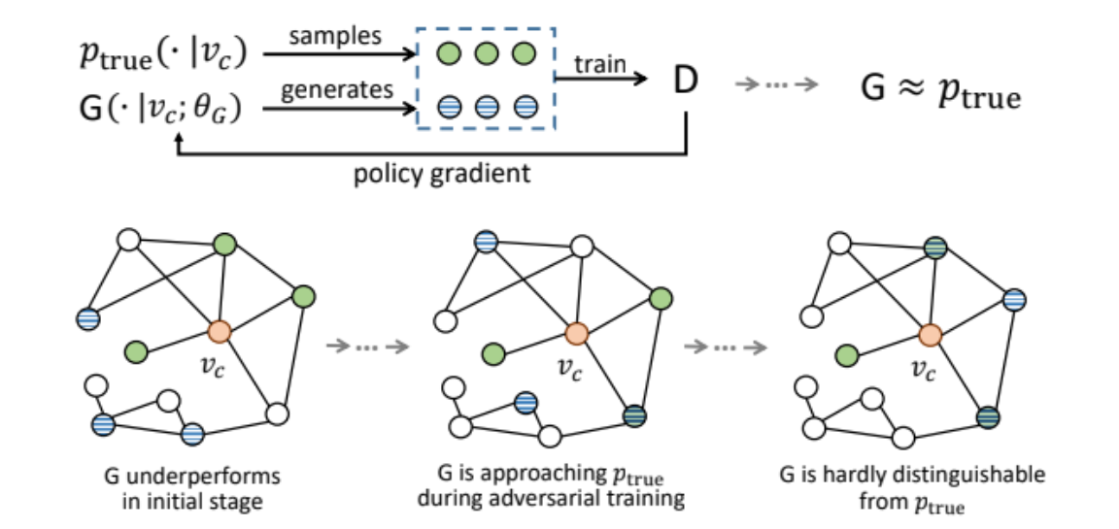
Graph-GAN
Vertices with higher probability of being labeled as nonimmediate neighbors become less likely to be sampled by generator.
Eventually, the generator produces an embedding of the graph.
6
Notes:
a framework that combines generative and discriminative models to improve performance in tasks such as link prediction, node classification, and recommendation.
discriminator
DynGAN and DynGAN-LSTM rely on Graph-GAN as the base for their implementation.

Slide 10

Project
Architecture
DynGAN and DynGAN-LSTM

Slide 11
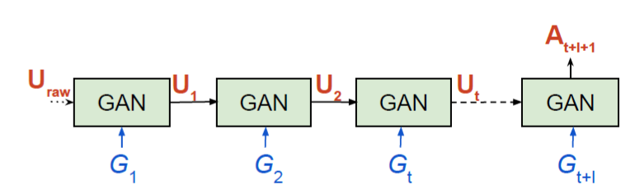
DynGAN
Snapshots:
This structure is able to handle evolving graphs by preserving the embeddings from the previous timestamps.
DynGAN is very suitable for link prediction but preforms poorly on graph prediction.
7
Notes:
Link prediction and graph prediction משפט

Slide 12
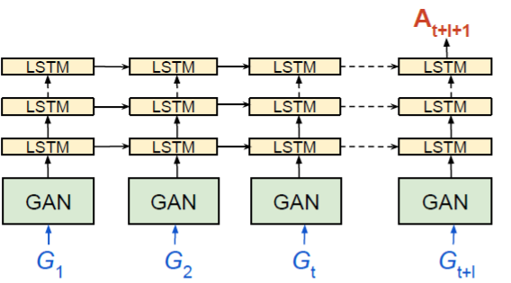
DynGAN-LSTM
Snapshots:
DynGAN-LSTM is successful at capturing the structural states of the network.
Utilized for the task of graph prediction.
8
Notes:
להסביר מה התוצאה
בשקף נוסף

Slide 13

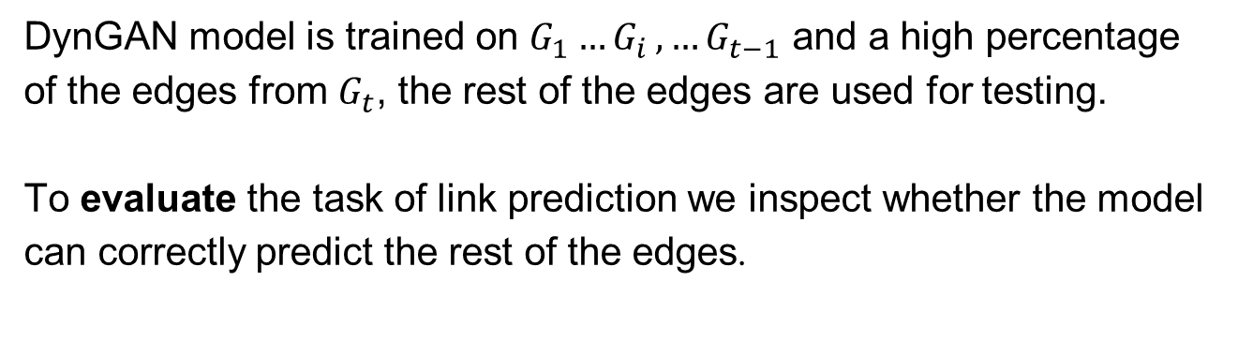
Link Prediction
DynGAN model is trained on $G_{1}{…G}_{i},…G_{t−1}$ and a high percentage of the edges from $G_{t}$, the rest of the edges are used for testing.
To evaluate the task of link prediction we inspect whether the model can correctly predict the rest of the edges.
9
Notes:
לא לשכוח לומר את החלק השני שאנחנו בודקים על גרף מוכן מראש

Slide 14
Implementation
System flow

Slide 15
System Flow
Input parameters
DynGAN-LSTM
Embedding Ud,Ug
Citation prediction
Analyze results
Present in GUI
10
Notes:
Analyze אנחנו מחשבים את האחוזים, מרכיבים את הגרף הצבוע וכו

Slide 16
Citation Prediction
To predict the modified snapshot (including the removed edges), we employ two edges lists: fake edges and removed edges.
At this stage the model outputs a lists of the new snapshot edges.
The goal is to correctly recover all removed edges and not include the fake edges.
11
Notes:
but suggest the presence of other articles indirectly connecting them.

Slide 17
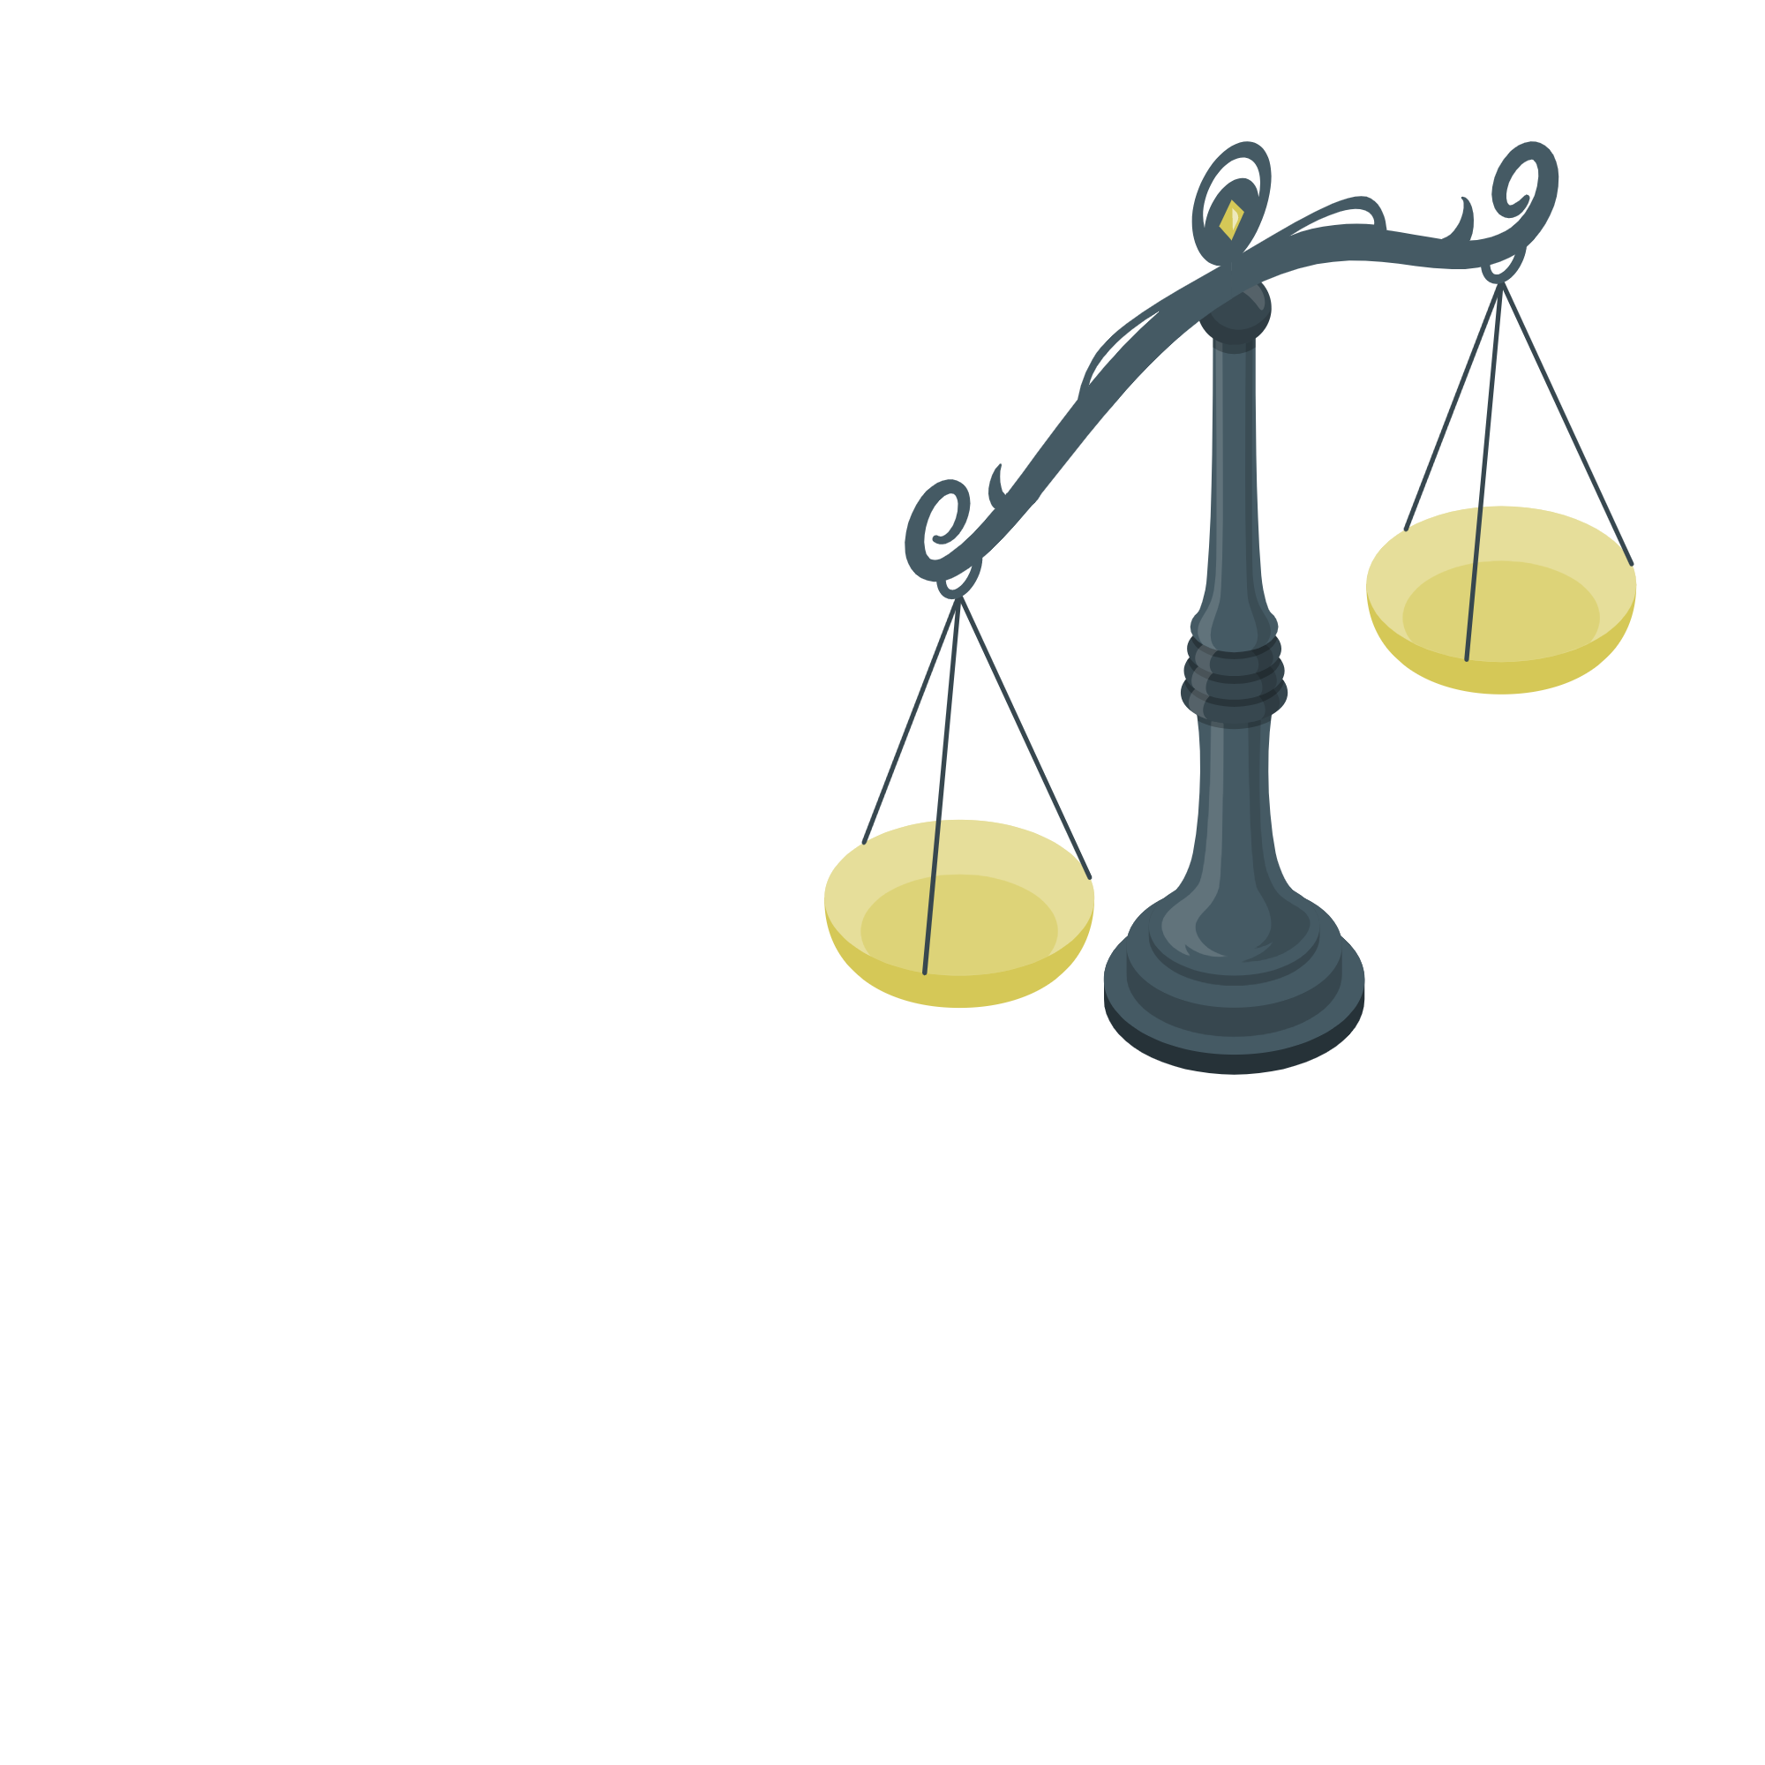
Citation Prediction
The embeddings are utilized to examine differences in edges between the sequential timestamps.
Connectivity probability is compared to a configurable threshold.
Low probability, may not necessarily imply misleading references.
Articles with a high connectivity probability are considered to be closely related.
12
Notes:
Median!

Slide 18
Analyze Resluts
We compare the prediction results to the original network.
The presented network includes three types of edge: red, green and gray.
We calculate the values of the confusion matrix to receive the accuracy, precision and recall values of the model.
13
Notes:
Analyze אנחנו מחשבים את האחוזים, מרכיבים את הגרף הצבוע וכו

Slide 19
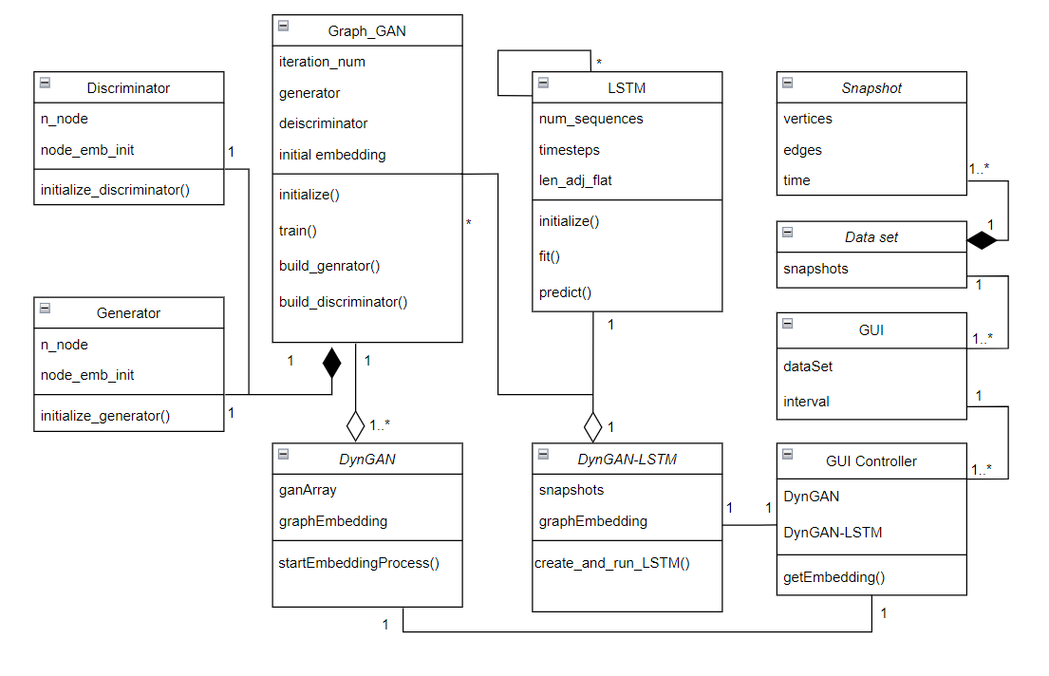
Class Diagram
14

Slide 20
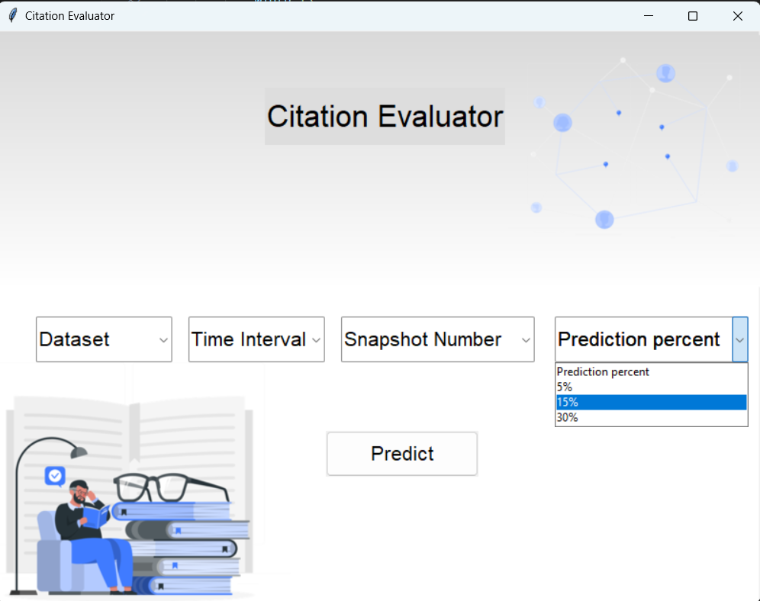
Graphical User Interface
15

Slide 21
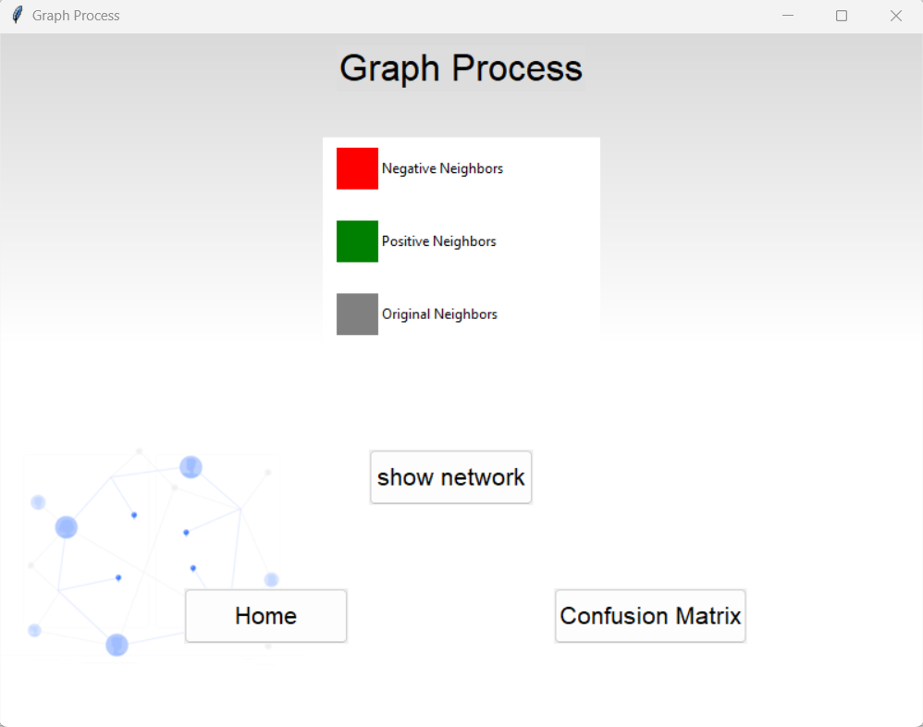
Graphical User Interface
16

Slide 22
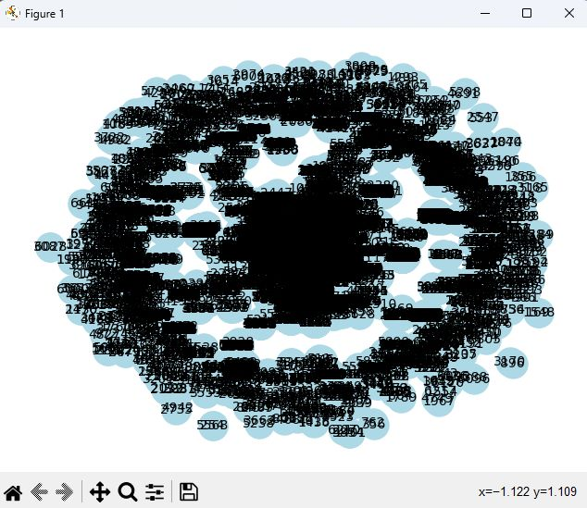
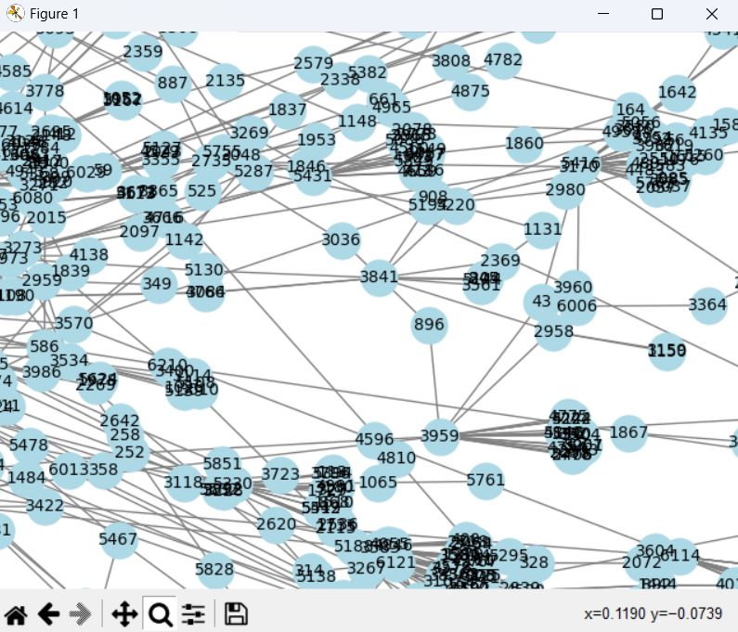
Graphical User Interface

Slide 23
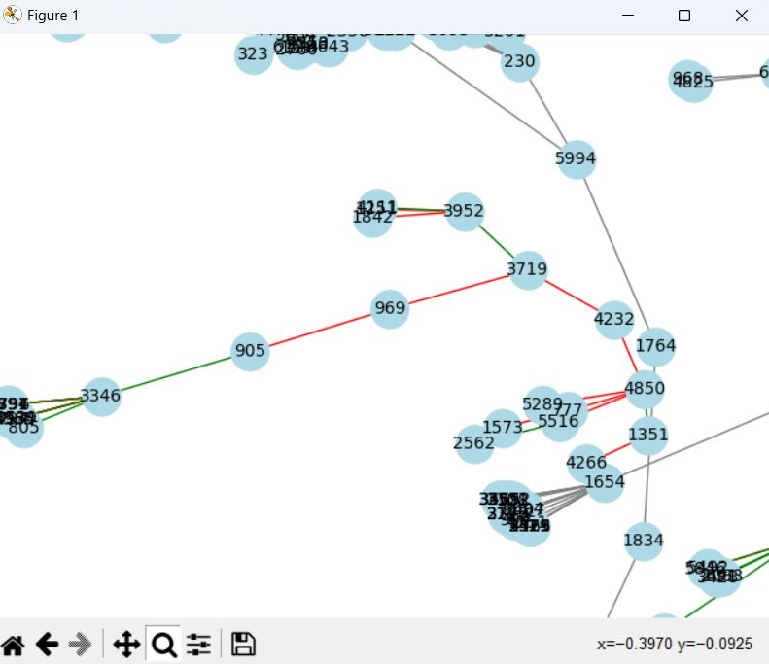
Graphical User Interface
17

Slide 24
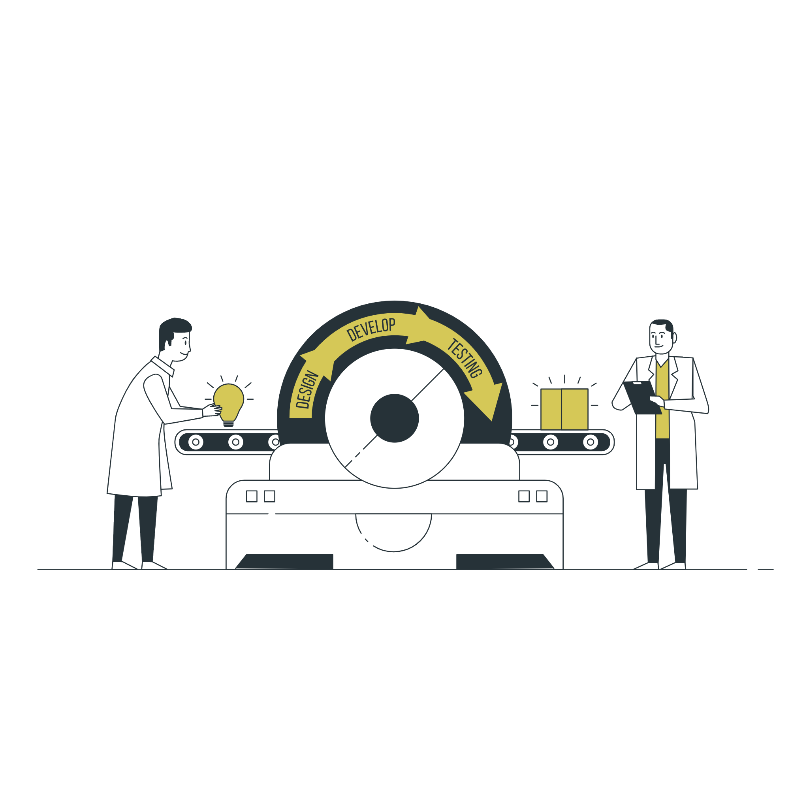
Results
Experiment Results
Notes:
דיברנו מקודם על בדיקה של האלוגוריתם

Slide 25
Experiment Results
Input parameters:
Dataset: iCite
Time interval: years
Snapshots number: 3
Prediction percent: 15%
6218 nodes
7178 edges
1101 removed edges
3 GAN components
3 LSTM layers
18

Slide 26



Expirement Results
TP | TN | FP | FN
577 | 587 | 522 | 523
Accuracy: $\frac{TP+TN}{TP+TN+FP+FN}=0.525$
Recall: $\frac{TP}{TP+FN}=0.525$
Precision: $\frac{TP}{TP+FP}=0.525$
19

Slide 27

Conclusions
Notes:
דיברנו מקודם על בדיקה של האלוגוריתם

Slide 28
Conclusions
The obtained results are better than those presented in the referenced paper [4].
Our implementation achieved an accuracy of 0.525, whereas the paper reported an accuracy of 0.465.
It can be inferred that this difference is attributable to two factors:
Data Size
Simpler Task
20
Notes:
The main reason for the enhancement of the results is due to the fact that the article tested the DynGAN-LSTM model on the task of graph prediction and not link prediction. We used the model for link prediction. This is a much simpler task

Slide 29
Challenges
Comprehending the GraphGAN code and adapting it for the DynGAN-LSTM model posed challenges.
Guidance from advisors and studying code documentation helped overcome challenges.
Lack of explicit instructions in the article prompted a trial-and-error process for replicating the architecture.
21
Notes:
The main reason for the enhancement of the results is due to the fact that the article tested the DynGAN-LSTM model on the task of graph prediction and not link prediction. We used the model for link prediction. This is a much simpler task

Slide 30

Thanks!
Do you have any questions?

Slide 31
References
GAN framework, slide 7 - Google Developers. "Overview of GAN Structure | Machine Learning |," n.d. https://developers.google.com/machine-learning/gan/gan_structure.
2. LSTM frameworks, slide 8- "Understanding LSTM Networks -- Colah's Blog," n.d. https://colah.github.io/posts/2015-08-Understanding-LSTMs/.
3. Graph-GAN framework, slide 10 -Wang, Hongwei, Jia Wang, Jialin Wang, Miao Zhao, Weinan Zhang, Fuzheng Zhang, Xing Xie, and Minyi Guo. "Graphgan: graph representation learning with generative adversarial nets (2017)." arXiv preprint arXiv:1711.08267.
4. DynGAN and DynGAN-LSTM - Maheshwari, Ayush, et al. "DynGAN: generative adversarial networks for dynamic network embedding." Graph representation learning workshop at NeurIPS. 2019.

